Slide 1
FIRST ANNOUNCEMENT
1st UNIFood
Conference
University of Belgrade
210th
Anniversary
October 5-6 2018 , Belgrade

Slide 2
In order to celebrate the 210th Anniversary of the University of Belgrade, we are pleased to announce
“UNIFOOD" Conference
which will be held October 5-6, 2018 in Belgrade, Serbia
www. http://unifood.rect.bg.ac.rs/
The organization of this event will be in line with the best results achieved by the University of Belgrade on the Academic Ranking of World Universities
ranked 35th Shanghai Ranking
in the field of Food Science and Technology
With the presence of eminent lecturers and scientists, researchers, entrepreneurs, industrial partners will share best practices to explore the future and trends in Food Science and Technology
Food Science and Technology have shown a growing interest throughout the world. From nature to standardized products, food is a major interest of a number of sectors, researching on all the related areas and encouraging multidisciplinary actions of all sectors for human welfare.

Slide 3
Topics are dedicated to management of food safety in a world of modern and global food systems, technology and additional benefits and risks including packaging standards, new food safety regulations and trends in food authentication, education, innovation and knowledge transfer, as well as influence on human health.
UNIFOOD will feature a series of presentations in keynote talks, oral presentations, poster presentations, roundtables, and discussions, for the purpose of engaging the participants in gaining new experiences and expanding their network of contacts. We hope that you will and join us by taking a part in the Conference.
We look forward to welcoming you in Belgrade!

Slide 4
CONFERENCE TOPICS:
Food and Health
Food Safety and Quality
Food Production, Processing and Sustainability
Food and Agricultural Economics
Agricultural and Food Production Engineering
Food Transportation in Food Supply Chain
Food and Farming Ethics
Education, Innovation and Knowledge Transfer

Slide 5
Abstracts could be submitted on any conference topics of interest. In addition to the plenary and invited lectures, we offer possibility for posters. All scientific contributions will be subjected to review process. The selection of oral presentations will be done based on the evaluation and recommendation of the Scientific Committee.
PLENARY LECTURES:
Prof. Dr Isabel C.F.R. Ferreira, Polytechnic Institute of Braganca, Coordinator of the Mountain Research Centre (CIMO), Portugal
Lecture title:
“The essential role of natural resources on novel bio-based food additives discovery pathway”
Prof. Dr Andreja Rajković, Faculty of Bioscience Engineering - Ghent University, Belgium Ghent University Global Campus - South Korea, Faculty of Agriculture - University of Belgrade
Lecture title:
“OMICS approaches in food safety risk assessment:
mixture exposure and host-pathogen interactions.”
Prof. Dr Luca Cocolin, Department of Agricultural, Forestry and Food Sciences University of Turin, Italy
Lecture title:
“Interactions in complex microbial communities in food”

Slide 6
INVITED LECTURES:
Dr. Mirjana Rajilić Stojanović, Faculty of Technology and Metallurgy - University of Belgrade
“Indigestible food components that stimulate symbiotic activity of gut microbiota”
Dr. Ana Ćirić, Institute for Biological Research “Siniša Stanković” - University of Belgrade
“Edible and medicinal mushrooms - The beneficial role of in human health”
Dr. Uroš Andjelković, Institute of Chemistry, Technology and Metallurgy - University of Belgrade
"Mass spectrometry as foodomics tool in research and control of food allergen proteins"
Prof. Dr. Mirjana Pešić, Faculty of Agriculture - University of Belgrade
“Structure and function of milk protein complexes generating during milk processing”
Dr. Bojana Vidović, Faculty of Pharmacy - University of Belgrade
“Application of scientific research in the development of the functional foods concept’’
Dr. Jelica Grujić Milanović, Institute for Medical Research - University of Belgrade
“Wine and health”
Dr. Milica Živković, Institute of Molecular Genetics and Genetic Engineering - University of Belgrade “Probiotic Applications of Exopolysaccharides-Producing Lactobacilli in Functional Food”
Dr. Jelena Trifković, Faculty of Chemistry - University of Belgrade
“Chemometrics in foodomics”

Slide 7
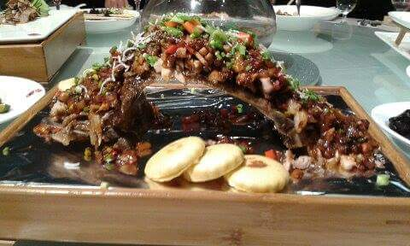
ROUND TABLE:
M. Sci. Ivanka Milenković, co-founder and director of private company EKOFUNGI ltd.
“Science and knowledge – a tool in the production of high-quality food”
Prof. Dr. Viktor Nedović, Faculty of Agriculture, University of Belgrade
“Encouraging of entrepreneurial way of thinking in the student’s population –
EcoTrohelia student’s competition”
Dr. Mljadjen Stojanović, Innovation Fund
“Science and economy in Serbia – mechanisms for incentivizing cooperation”
Privredna komora

Slide 8
IMPORTANT DATES
Second annoucement …
Registration deadline: 15th May 2018.
Abstract submission deadline: 15th June 2018.
Draft programme published: 15th September 2018.
All the information concerning registration, abstract submision and accommodation will be available on the UNIFood webpage http://unifood.rect.bg.ac.rs/, or emil: unifood@rect.bg.ac.rs

Slide 9
Registration fees:
210 Dinars
2.10 Euros
More details could be seen at website of the UNIFood conference:
http://unifood.rect.bg.ac.rs/
Official language:
Serbian | English

Slide 10
Scientific committee
Dr. Marina Soković - Institute for Biological Research "Siniša Stanković", Chair
Prof. Dr. Vladimir Bumbaširević - School of Medicine
Prof. Dr. Živoslav Tešić - Faculty of Chemistry
Prof. Dr. Mirjana Pešić - Faculty of Agriculture
Prof. Dr. Ljiljana Mojović - Faculty of Technology and Metallurgy
Prof. Dr. Jelena Lozo - Faculty of Biology
Prof. Dr. Ljiljana Gojković-Bukarica - School of Medicine
Dr. Dragana Stanić-Vučinić - Faculty of Chemistry
Prof. Dr. Bojana Vidović - Faculty of Pharmacy
Prof. Dr Sladjana Sobajic - Faculty of Pharmacy
Prof. Dr. Slavica Todić - Faculty of Agriculture
Prof. Dr. Dušanka Milojković-Opsenica - Faculty of Chemistry
Prof. Dr. Andreja Rajković - Faculty of Agriculture
Prof. Dr. Nikola Tomić - Faculty of Agriculture
Prof. Dr. Viktor Nedović - Faculty of Agriculture
Prof. Dr. Miomir Nikšić - Faculty of Agriculture
Prof. Dr. Branko Bugarski - Faculty of Technology and Metallurgy
Dr. Nataša Golić - Institute of Molecular Genetics and Genetic Engineering
Prof. Dr. Ivan Stanković - Faculty of Pharmacy
Prof. Dr. Jagoda Jorga - School of Medicine
Prof. Dr. Nebojša Lalić - School of Medicine
Dr. Miroslav Novaković - Institute of Chemistry, Technology and Metallurgy
Dr. Uroš Anđelković - Institute of Chemistry, Technology and Metallurgy
Dr. Danijela Mišić - Institute for Biological Research "Siniša Stanković"
Dr. Vuk Maksimović - Institute for Multidisciplinary Research
Dr. Nevena Mihailović-Stanojević - Institute for Medical Research
Prof. Dr. Jevrosima Stevanović - Faculty of Veterinary Medicine
Veljko Jovanović - Director of Chamber of Commerce and Industry of Serbia
Aleksandar Bogunović - Secretary of Chamber of Commerce and Industry of Serbia
Organizing committee
Dr. Vladimir Mikić
Vladimir Marković
Ivana Isaković
Dr. Ana Jakovljević
Branka Janda-Marković
Nikola Savić
Snežana Pejović
Daniel Babić
Aleksandar Topalović
Ljiljana Konstantinović
Ljubica Dimitrijević

Slide 11
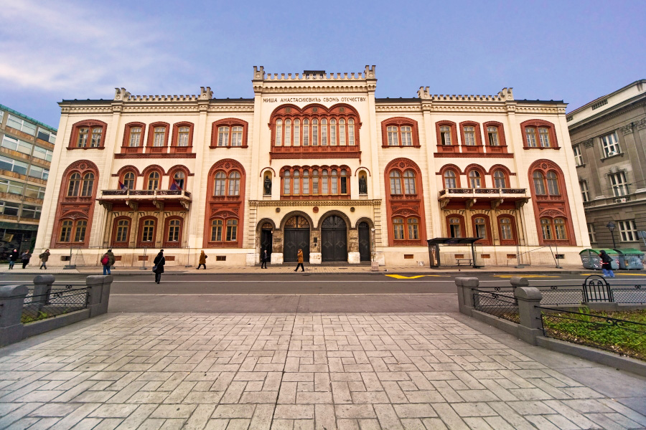
Conference venue University of Belgrade Rectory
The Conference will take place in the congress hall and other facilities of the University of Belgrade Rectory. Important jubilee will be pointed out, 210 years from the founding of the University of Belgrade

